Slide 1
流感疫苗
高雄醫學大學附設中和紀念醫院
衛生福利部屏東醫院
感染科 郭政諭醫師

Slide 2
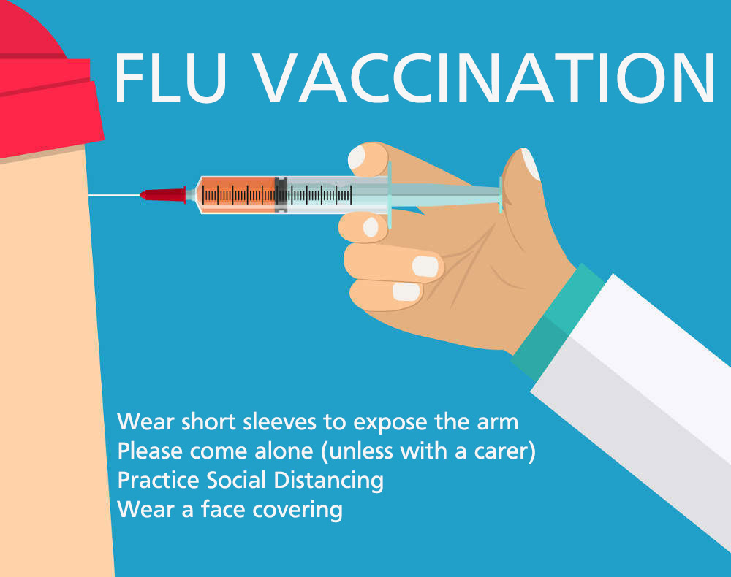
A yearly flu vaccine as the first and most important step in protecting against flu viruses

Slide 3
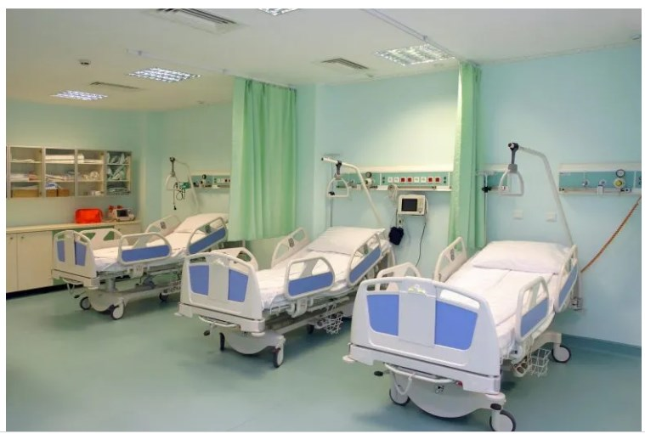
Why should people get vaccinated against flu?
Influenza is a potentially serious disease that can lead to hospitalization and sometimes even death.

Slide 4
Why do I need a flu vaccine every year?
A person’s immune protection from vaccination declines over time.
Because flu viruses are constantly changing, the composition of flu vaccines is reviewed annually
  vaccines are updated to protect against the viruses that research indicates will be most common during the upcoming flu season.

Slide 5
Flu vaccination can keep you from getting sick with flu
Flu vaccination prevents millions of illnesses and flu-related doctor’s visits each year.
  during 2019-2020 flu vaccination prevented
    7.5 million influenza illnesses,
    3.7 million influenza-associated medical visits,
    105,000 influenza-associated hospitalizations,
    6,300 influenza-associated deaths.
During seasons when flu vaccine viruses are similar to circulating flu viruses,
  flu vaccine has been shown to reduce the risk of having to go to the doctor with flu by 40% to 60%.

Slide 6
Flu Vaccine Reduces Risk of Severe Illness
The study was conducted over four flu seasons from 2012 to 2015 and found that flu vaccination prevented severe disease
Flu vaccination among adults reduced the risk of being admitted to the hospital with flu
  placed in a general ward bed by 37 percent.
Flu vaccination was even more effective in preventing the most severe forms of flu
  reduced the risk of being admitted to an ICU with flu by 82 percent.

Slide 7
Flu vaccines prevented influenza-associated ICU admissions
Have higher effectiveness in ICU than GW hospital settings
Influenza vaccine effectiveness for GW patients was 41% (95% CI = 29–51%)
Influenza vaccine effectiveness for ICU patients was 86% (95% CI = 54–96%)
In the propensity adjusted models, for all estimated seasons, influenza virus (sub)types, with or without chronic medical conditions, and by age group (<65 vs. 65 years)
  influenza vaccine effectiveness point estimates for ICU patients were > 70% (range = 73–95%) and consistently higher than influenza vaccine effectiveness point estimates among GW patients (range = 14–66%)
Vaccine, 18 September 2018, Pages 5916-5925

Slide 8
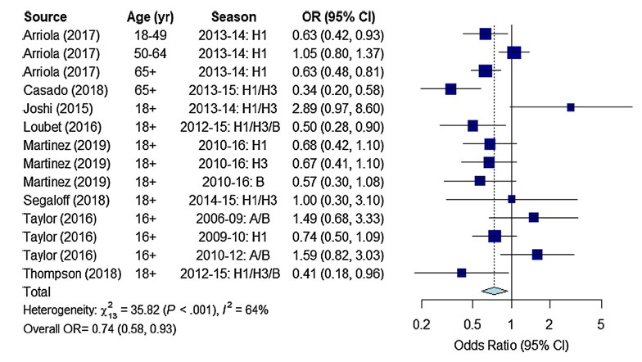
Flu vaccination with 26% reduction in odds of ICU admission among adults
Vaccine 39 (2021) 3678–3695

Slide 9
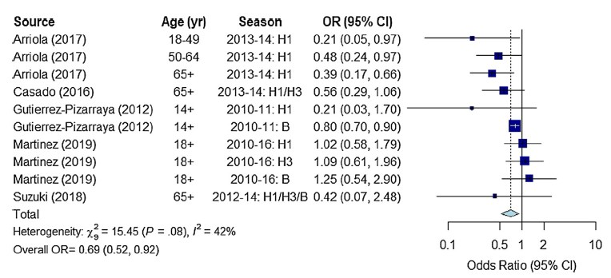
Vaccinated patients had 31% reduced risk of death compared with unvaccinated patients
Vaccine 39 (2021) 3678–3695

Slide 10
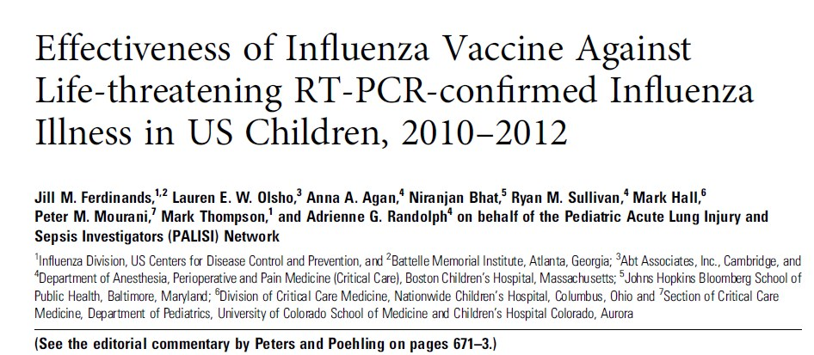
Flu vaccination reduced children’s risk of flu-related pediatric intensive care unit (PICU) admission by 74 percent during flu seasons from 2010-2012.
The Journal of Infectious Diseases 2014;210:674–83

Slide 11
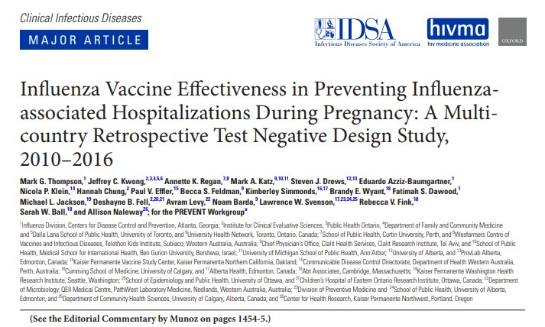
Getting a flu shot reduced a pregnant person’s risk of being hospitalized with flu by an average of 40 percent from 2010-2016
Clinical Infectious DiseasesR 2018;68(9):1444–53

Slide 12


Who Should Vaccinate?
Everyone 6 months of age and older should get an influenza vaccine every season with rare exception.

Slide 13
110 年度流感疫苗接種計畫各類實施對象
滿 6 個月以上至國小入學前幼兒
國小、國中、高中、高職、五專 1 至 3 年級學生
50 歲以上成人
具有潛在疾病，符合下列條件之一者
  高風險慢性病人，符合下列條件之一者： （一）具有糖尿病、慢性肝病（含肝硬化）、心血管疾病（不含單純高 血壓）、慢性肺病、腎臟疾病及免疫低下（HIV 感染者）等疾病 之門、住診紀錄之患者（疾病代碼供參如附件 1）。 （二）無法取得上開疾病之門、住診紀錄，但經醫師評估符合者。 （三）BMI≧30 者。
  罕見疾病患者。
  重大傷病患者（健保卡內具註記或領有重大傷病證明紙卡者）。
孕婦及 6 個月內嬰兒之父母
幼兒園托育人員及托育機構專業人員
安養、養護、長期照顧(服務)等機構之受照顧者及所屬工作人員
事及衛生等單位之防疫相關人員
禽畜養殖等相關行業工作人員、動物園工作人員及動物防疫人員

Slide 14
How Influenza Vaccines Are Made
Egg-Based Flu Vaccines
Cell-Based Flu Vaccines
Recombinant Flu Vaccines

Slide 15
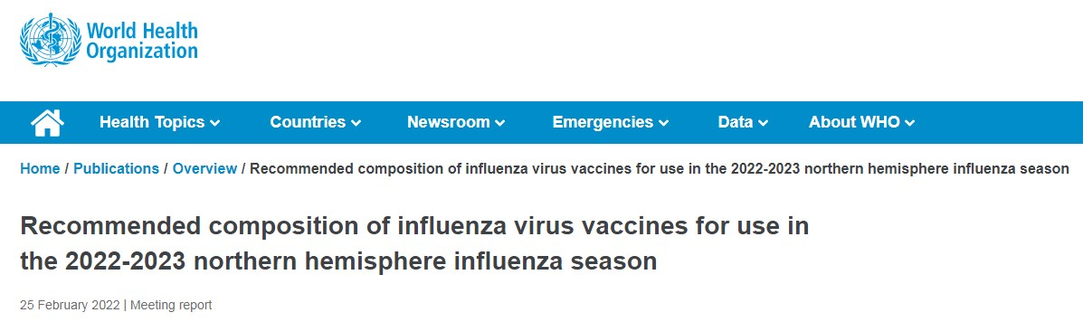
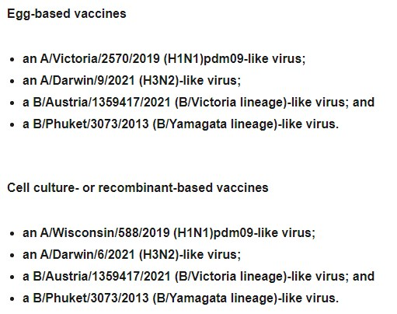

Slide 16
Different Types of Flu Vaccines
Live Attenuated Influenza Vaccine [LAIV] (The Nasal Spray Flu Vaccine)
Quadrivalent Influenza Vaccine
Fluzone High-Dose Seasonal Influenza Vaccine
Adjuvanted Flu Vaccine
Cell-Based Flu Vaccines
Recombinant Influenza Vaccine
Flu Vaccination by Jet Injector

Slide 17
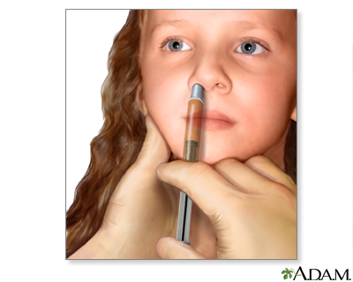
Live Attenuated Influenza Vaccine
(The Nasal Spray Flu Vaccine)
The nasal spray flu vaccine is approved for use in healthy non-pregnant people, 2 through 49 years old.

Slide 18
Who should not get the nasal spray flu vaccine
Children younger than 2 years old
Adults 50 years and older
People with a history of severe allergic reaction to any ingredient of the vaccine or to a previous dose of any flu vaccine
Children 2 through 17 years old who are receiving aspirin- or salicylate-containing medications.
Children 2 through 4 years old who have asthma or who have had a history of wheezing in the past 12 months
People with weakened immune systems (immunosuppression) from any cause
People who care for severely immunocompromised persons who require a protected environment
People without a spleen, or with a non-functioning spleen
Pregnant people
People with an active leak between the CSF and the mouth, nose, ear, or other place within the skull
People with cochlear implants
People who have taken flu antiviral drugs within a certain amount of time. (48 hours for oseltamivir and zanamivir, 5 days for peramivir, and 17 days for baloxavir.)

Slide 19
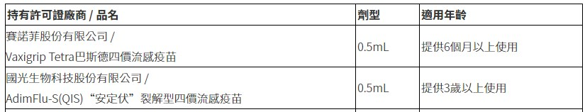
Quadrivalent Influenza Vaccine
Adding a B virus from the second lineage was done to give broader protection against circulating flu viruses.

Slide 20
Fluzone High-Dose Seasonal Influenza Vaccine
A four-component (quadrivalent) flu vaccine approved for people 65 years and older.
Fluzone High-Dose Quadrivalent contains four times the antigen than Fluzone Quadrivalent and other standard-dose inactivated flu vaccines.
  The higher dose of antigen in the vaccine is intended to give people 65 years and older a better immune response to vaccination, and therefore, better protection against flu.

Slide 21
Fluzone High-Dose Seasonal Influenza Vaccine
A stronger immune response (i.e., higher antibody levels) occured after vaccination with Fluzone High-Dose.
The high-dose vaccine was 24% more effective in preventing flu in adults 65 years and older relative to a standard-dose vaccine.
People 65 years and older who got Fluzone High-dose had a lower risk of hospital admission compared with people in that age group who got the standard-dose Fluzone, especially those living in long-term care facilities.
Some side effects were reported more frequently after vaccination with trivalent Fluzone High-Dose than after standard-dose inactivated flu vaccines.
N Engl J Med 2014; 371:635-645
Lancet Respir Med. 2017 Sep;5(9):738-746

Slide 22
Adjuvanted Flu Vaccine
An adjuvant is an ingredient of a vaccine that helps promote a better immune response.
Adjuvants also can reduce the amount of virus needed for production of a vaccine,
  can allow for greater supplies of vaccine to be manufactured.

Slide 23
Cell-Based Flu Vaccines
The cell-based vaccine manufacturing process uses animal cells (Madin-Darby Canine Kidney, or MDCK cells) as a host for the growing flu viruses instead of fertilized chicken eggs.
Growing flu viruses in eggs can introduce changes (called egg-adapted changes) that can cause differences between the viruses in the vaccine and the ones that are circulating.

Slide 24
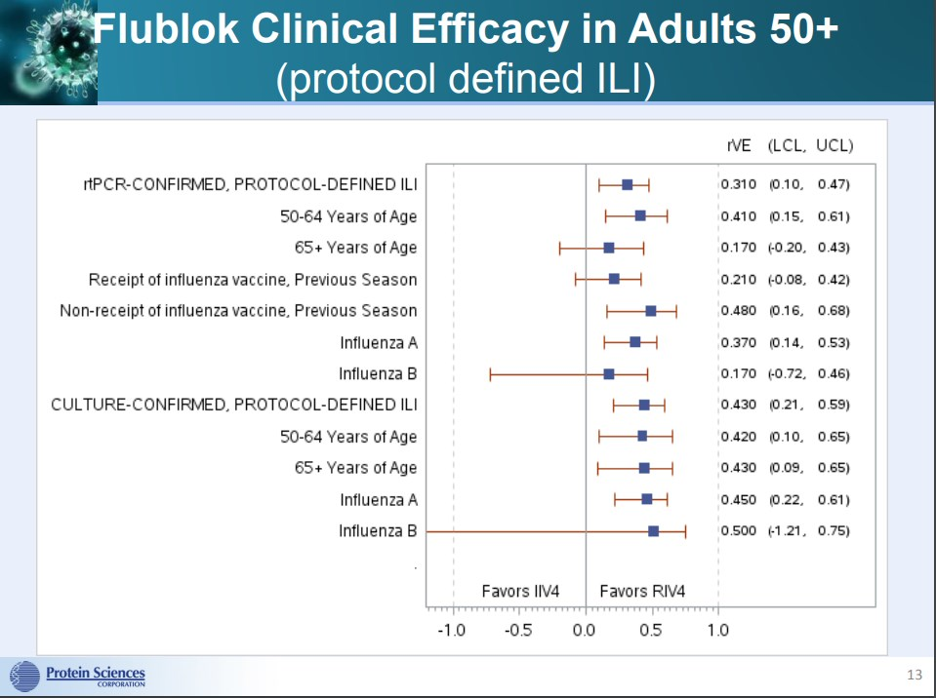
Recombinant Influenza Vaccine
Recombinant influenza (flu) vaccines are produced using recombinant technology.

Slide 25
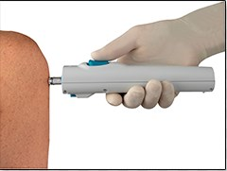
Flu Vaccination by Jet Injector
A jet injector is a medical device used for vaccination
  uses a high-pressure, narrow stream of fluid to penetrate the skin instead of a needle.

Slide 26
Are any of the available flu vaccines recommended over others?
inactivated influenza vaccine (IIV4), recombinant influenza vaccine (RIV4), or live attenuated nasal spray influenza vaccine (LAIV4) with no preference expressed for any one vaccine over another.

Slide 27
流感疫苗安全嗎? 會有什麼副作用 ?
疫苗與其他任何藥品一樣有可能造成副作用，包括接種後可能會有注射部位疼痛、紅腫，少數的人則會有全身性的輕微反應，如：發燒、頭痛、肌肉酸痛、噁心、皮膚搔癢、蕁麻疹或紅疹等，ㄧ般會在發生後1-2天內自然恢復。
嚴重的副作用，如立即型過敏反應，甚至過敏性休克等不適情況（臨床表現包括呼吸困難、聲音沙啞、氣喘、眼睛或嘴唇腫脹、頭昏、心跳加速等），發生機率非常低，若不幸發生，通常於接種後幾分鐘至幾小時內即出現症狀。
其他曾被零星報告過之不良事件包括神經系統症狀（如：臂神經叢炎、顏面神經麻痺、熱痙攣、腦脊髓炎、以對稱性神經麻痺為表現的Guillain-Barré症候群等）和血液系統症狀（如：暫時性血小板低下，臨床表現包括皮膚出現紫斑或出血點、出血時不易止血等）。

Slide 28
哪些人不適合接種流感疫苗?
已知對疫苗的成分有過敏者，不予接種
過去注射曾經發生嚴重不良反應者，不予接種

Slide 29
對雞蛋/蛋的蛋白質過敏者
是否可接種流感疫苗 ?
雞蛋過敏大多發生於接觸後30分鐘內，常見症狀是皮膚出疹與搔癢
依現有針對雞胚胎蛋培養製造法之不活化流感疫苗研究顯示，對於曾因吃蛋發生嚴重過敏症狀者，仍可在門/住診由熟悉處理過敏症狀醫事人員提供接種，並於接種後觀察30分鐘，無不適症狀再離開。

Slide 30
接種流感疫苗有哪些注意事項 ?
發燒或正患有急性中重疾病者，宜待病情穩定後再接種。
出生未滿6個月，因無使用效益及安全性等臨床資料，故不予接種。
先前接種本疫苗6週內曾發生Guillain-Barré 症候群(GBS)者，宜請醫師評估。
已知對「蛋」之蛋白質有嚴重過敏者，可在門/住診由熟悉處理過敏症狀之醫事人員提供接種，並於接種後觀察30分鐘，無不適症狀再離開。
其他經醫師評估不適合接種者，不予接種。

Slide 31
流感疫苗接種後注意事項 ?
接種疫苗後有相當小的機率會發生立即型過敏反應，並導致過敏性休克。為了能在事件發生後立即進行醫療處置，接種疫苗後應於接種單位或附近稍做休息，並觀察至少30分鐘以上，待無不適後再離開。
使用抗血小板或抗凝血藥物或凝血功能異常者，施打後於注射部位加壓至少2分鐘，並觀察是否仍有出血或血腫情形。
接種後應注意有無持續發燒（超過48小時）、呼吸困難、心跳加速、意識或行為改變等異常狀況，如有不適，應儘速就醫，告知醫師相關症狀、症狀發生時間、疫苗接種時間，以做為診斷參考，並通報當地衛生局。

Slide 32
流感疫苗可否與其他疫苗或COVID-19疫苗同時接種?
流感疫苗是不活化疫苗，可以和其他疫苗同時接種於不同部位，或間隔任何時間接種。
經110年8月28日衛生福利部傳染病防治諮詢會預防接種組建議，為避免一旦發生不良事件時無法釐清歸因，接種流感疫苗應與COVID-19疫苗間隔至少7天。

Slide 33
Conclusion
The best way to reduce your risk from seasonal flu and its potentially serious complications is to get vaccinated every year.

Slide 34
謝謝聆聽

Slide 35
接種流感疫苗的保護效果如何?
根據國外文獻，流感疫苗之保護力因年齡或身體狀況不同而異，平均約可達30-80%。
對18歲以上成人因確診流感而住院的保護力約有41%，入住加護病房的流感重症保護力則可達82%。
6個月至未滿18歲兒童青少年族群接種流感疫苗之保護力與成人相仿。
此外，疫苗保護效果亦需視當年疫苗株與實際流行的病毒株型別是否相符，一般保護力會隨病毒型別差異加大而降低。

